Slide 1
Problem Solving in Recursion
Combinatorics * * * Strings * * * 8 Queens

Slide 2
Recap: Why Recursion
Neat in theory
Leads to very clean code in most cases
Recap: Recursion Strategy
Figure out what the base case (simplest case) consists of
The base case must returns a result immediately
All other conditions must revert to base case

Slide 3
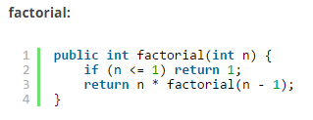
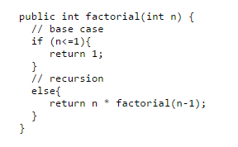
Writing Factorial as Recursion (see previous lecture/tutorial)

Slide 4
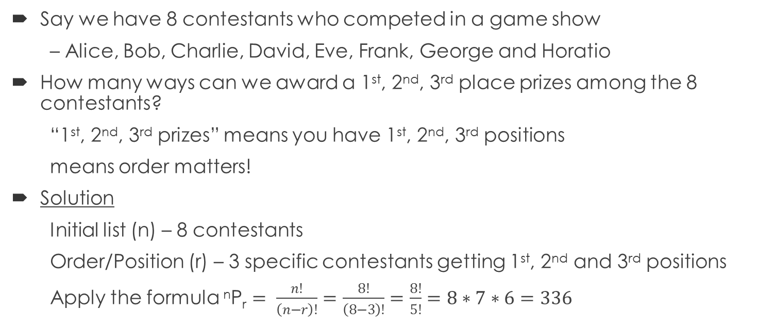
A Permutation Problem - all possible ways of listing something in a particular order
Say we have 8 contestants who competed in a game show
– Alice, Bob, Charlie, David, Eve, Frank, George and Horatio
How many ways can we award a 1st, 2nd, 3rd place prizes among the 8 contestants?
“1st, 2nd, 3rd prizes” means you have 1st, 2nd, 3rd positions
means order matters!
Solution
Initial list (n) – 8 contestants
Order/Position (r) – 3 specific contestants getting 1st, 2nd and 3rd positions
Apply the formula ^{n}P_{r} $= \frac{n!}{\left(n−r\right)!}=\frac{8!}{\left(8−3\right)!}=\frac{8!}{5!}=8∗7∗6=336$

Slide 5
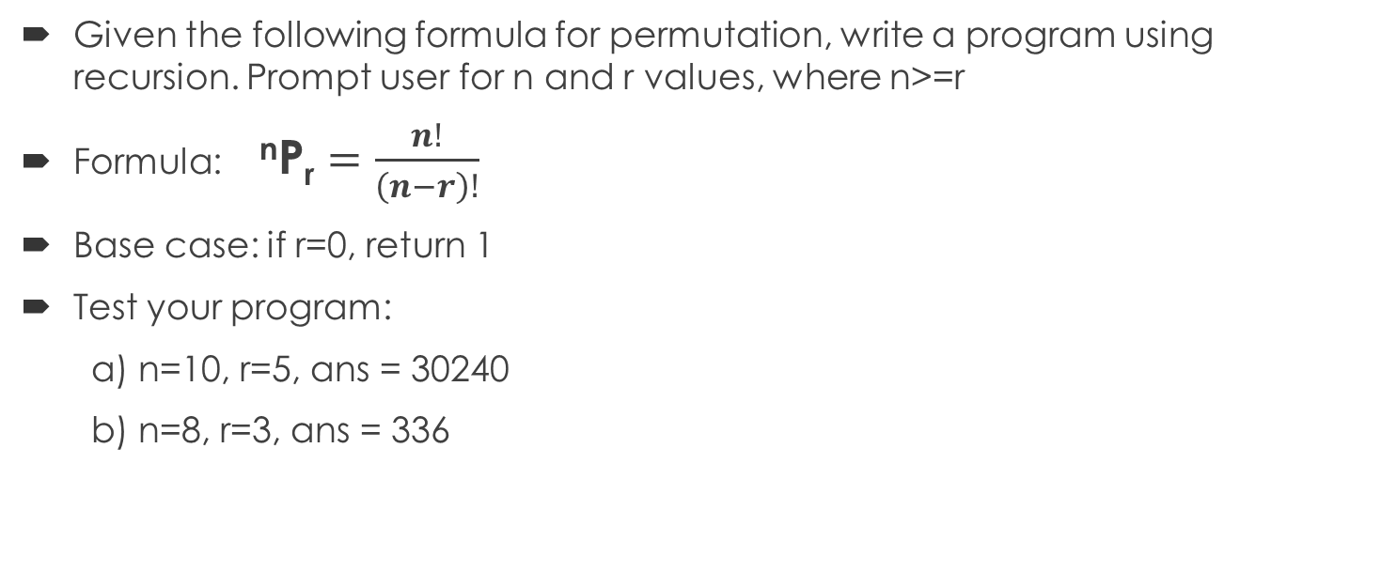
A Permutation Problem - all possible ways of listing something in a particular order
Given the following formula for permutation, write a program using recursion. Prompt user for n and r values, where n>=r
Formula: ^{n}P_{r} $=\frac{n!}{\left(n−r\right)!}$
Base case: if r=0, return 1
Test your program:
a) n=10, r=5, ans = 30240
b) n=8, r=3, ans = 336

Slide 6
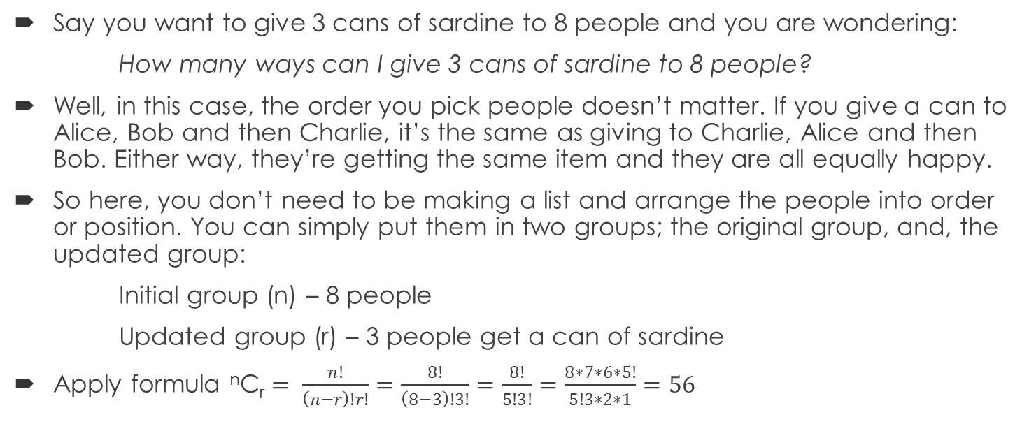
A Combination Problem - all possible ways of arranging things (orders are not important)
Say you want to give 3 cans of sardine to 8 people and you are wondering:
How many ways can I give 3 cans of sardine to 8 people?
Well, in this case, the order you pick people doesn’t matter. If you give a can to Alice, Bob and then Charlie, it’s the same as giving to Charlie, Alice and then Bob. Either way, they’re getting the same item and they are all equally happy.
So here, you don’t need to be making a list and arrange the people into order or position. You can simply put them in two groups; the original group, and, the updated group:
Initial group (n) – 8 people
Updated group (r) – 3 people get a can of sardine
Apply formula ^{n}C_{r} $= \frac{n!}{\left(n−r\right)!r!}=\frac{8!}{\left(8−3\right)!3!}=\frac{8!}{5!3!}=\frac{8∗7∗6∗5!}{5!3∗2∗1}=56$

Slide 7
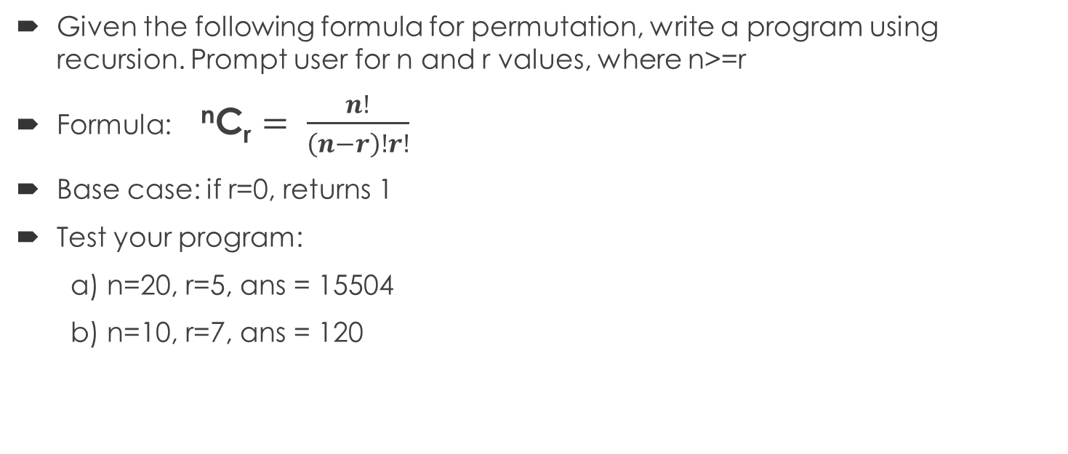
A Combination Problem - all possible ways of arranging things (orders are not important)
Given the following formula for permutation, write a program using recursion. Prompt user for n and r values, where n>=r
Formula: ^{n}C_{r} $= \frac{n!}{\left(n−r\right)!r!}$
Base case: if r=0, returns 1
Test your program:
a) n=20, r=5, ans = 15504
b) n=10, r=7, ans = 120

Slide 8
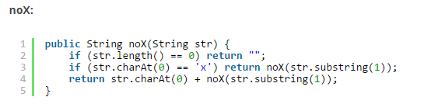
String Problem1
Given a string, compute recursively a new string where all the ‘x’ chars have been removed
Test:
a) “xaxb” = “ab”
b) “ghy” = “ghy”
c) “xxxx” = “”

Slide 9
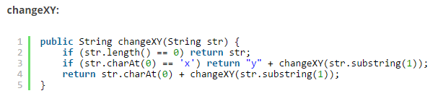
String Problem2
Given a string, compute recursively a new string where all lowercase ‘x’ chars are changed to lowercase ‘y’ chars
Test:
a) "codex" → "codey" b) "xxhixx" → "yyhiyy" c) "xhixhix" → "yhiyhiy"

Slide 10
8 Queen Problem - a classic example of complex recursion problem - solved using recursion & backtracking exhaustive search
The goal is to keep (up to) 8 queens on the regular chessboard (8x8) in such a way that no queen attacks the other.
A queen may move row wise, column wise and in both diagonals
The idea/logic is one must first design the program to check how many queens are there on the board and what are their current positions (i,j).
Then, one must allow the queen(s) to be on-board only if they are:
a) unique in their own row
b) unique in their own column
c) unique in both diagonals
Links to sample solutions:
http://introcs.cs.princeton.edu/java/23recursion/Queens.java

